Slide 1
CSIS3764 Data Science
^{Mr WSJ Marais}
Data Science Methodology

Slide 2
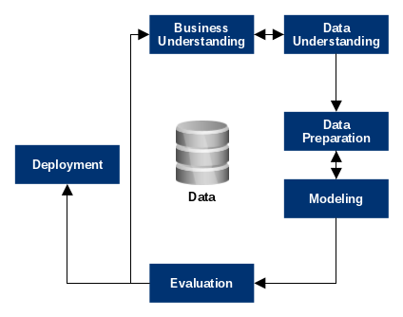
CRISP-DM (1999)
https://towardsdatascience.com/data-science-career-reflection-based-on-crisp-dm-process-model-aedd8542b019

Slide 3
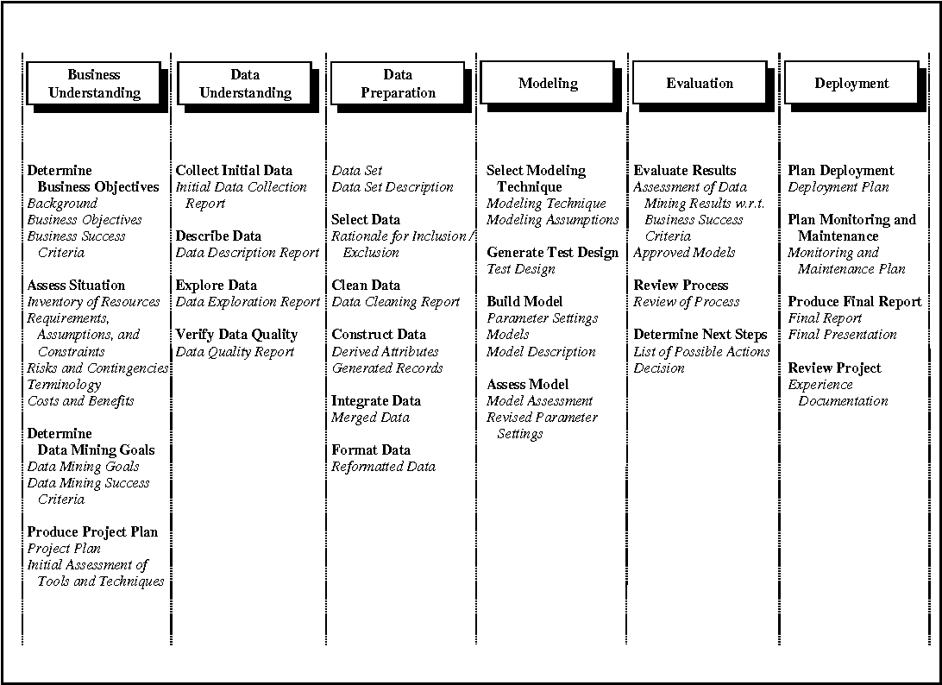
https://www.semanticscholar.org/paper/Crisp-dm%3A-towards-a-standard-process-modell-for-Wirth-Hipp/48b9293cfd4297f855867ca278f7069abc6a9c24/figure/2

Slide 4
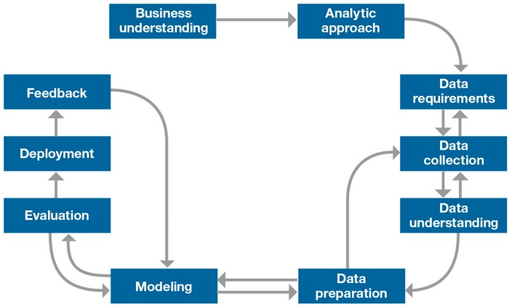
Data Science Methodology (2015)
Foundational Methodology for Data Science (Rollins, 2015)
https://towardsdatascience.com/data-science-methodology-101-ce9f0d660336

Slide 5
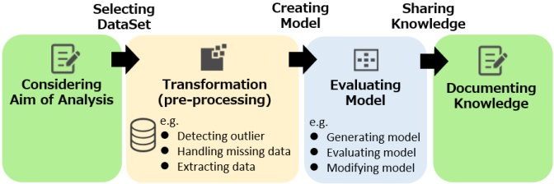
APREP-DM (2019)
Data-mining workflow: Green denotes an interaction with the client, yellow a data transformation and blue the analysis model.
2019 IEEE International Conference on Pervasive Computing and Communications Workshops (PerCom Workshops)

Slide 6
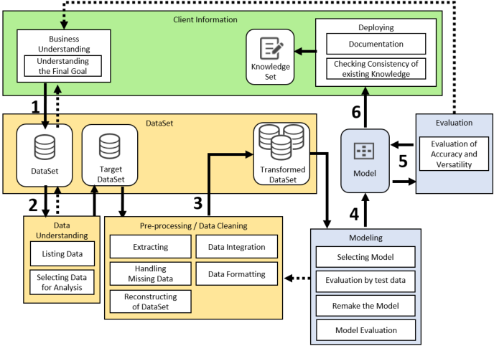
APREP-DM (2019)
2019 IEEE International Conference on Pervasive Computing and Communications Workshops (PerCom Workshops)

Slide 7
Data Science Elements
Data Exploration and Analysis
NumPy
SciPy
Pandas (https://pandas.pydata.org/pandas-docs/version/0.15/tutorials.html)
Data Visualization
Matplotlib (https://matplotlib.org/stable/gallery/index.html)
Seaborn (https://seaborn.pydata.org/examples/index.html)
Machine Learning
Scikit-learn (https://scikit-learn.org/stable/)
Deep Learning
Tensorflow (https://www.tensorflow.org/tutorials)
Keras (https://keras.io/guides/)
PyTorch (https://pytorch.org/tutorials/)

Slide 8
Data Science Elements
Data Storage
Apache Spark
Apache Hadoop
HDFS
Real World Applications
Information Security
Computational Linguistics
NLP
Image Processing
Speech Processing

